Slide 1
Computer Architecture
A Quantitative Approach, Sixth Edition
Chapter 3
Instruction-Level Parallelism and Its Exploitation

Slide 2
Introduction
Introduction
Pipelining become universal technique in 1985
Overlaps execution of instructions
Exploits “Instruction Level Parallelism”
Beyond this, there are two main approaches:
Hardware-based dynamic approaches
Used in server and desktop processors
Not used as extensively in PMP processors
Compiler-based static approaches
Not as successful outside of scientific applications

Slide 3
Instruction-Level Parallelism
Introduction
When exploiting instruction-level parallelism, goal is to maximize CPI
Pipeline CPI =
Ideal pipeline CPI +
Structural stalls +
Data hazard stalls +
Control stalls
Parallelism with basic block is limited
Typical size of basic block = 3-6 instructions
Must optimize across branches

Slide 4
Data Dependence
Introduction
Loop-Level Parallelism
Unroll loop statically or dynamically
Use SIMD (vector processors and GPUs)
Challenges:
Data dependency
Instruction j is data dependent on instruction i if
Instruction i produces a result that may be used by instruction j
Instruction j is data dependent on instruction k and instruction k is data dependent on instruction i
Dependent instructions cannot be executed simultaneously

Slide 5
Data Dependence
Introduction
Dependencies are a property of programs
Pipeline organization determines if dependence is detected and if it causes a stall
Data dependence conveys:
Possibility of a hazard
Order in which results must be calculated
Upper bound on exploitable instruction level parallelism
Dependencies that flow through memory locations are difficult to detect

Slide 6
Name Dependence
Introduction
Two instructions use the same name but no flow of information
Not a true data dependence, but is a problem when reordering instructions
Antidependence: instruction j writes a register or memory location that instruction i reads
Initial ordering (i before j) must be preserved
Output dependence: instruction i and instruction j write the same register or memory location
Ordering must be preserved
To resolve, use register renaming techniques

Slide 7
Other Factors
Introduction
Data Hazards
Read after write (RAW)
Write after write (WAW)
Write after read (WAR)
Control Dependence
Ordering of instruction i with respect to a branch instruction
Instruction control dependent on a branch cannot be moved before the branch so that its execution is no longer controlled by the branch
An instruction not control dependent on a branch cannot be moved after the branch so that its execution is controlled by the branch

Slide 8
Examples
Introduction
Example 1:
add x1,x2,x3
beq x4,x0,L
sub x1,x1,x6
L: …
or x7,x1,x8
Example 2:
add x1,x2,x3
beq x12,x0,skip
sub x4,x5,x6
add x5,x4,x9
skip:
or x7,x8,x9
or instruction dependent on add and sub
Assume x4 isn’t used after skip
Possible to move sub before the branch

Slide 9
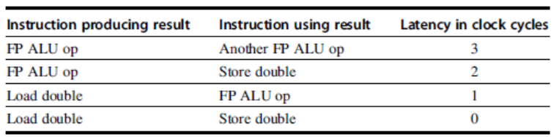
Compiler Techniques for Exposing ILP
Compiler Techniques
Pipeline scheduling
Separate dependent instruction from the source instruction by the pipeline latency of the source instruction
Example:
for (i=999; i>=0; i=i-1)
x[i] = x[i] + s;

Slide 10
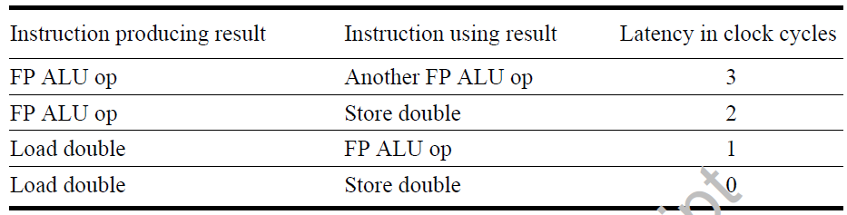
Pipeline Stalls
Compiler Techniques
Loop: fld f0,0(x1)
stall
fadd.d f4,f0,f2
stall
stall
fsd f4,0(x1)
addi x1,x1,-8
bne x1,x2,Loop
Loop: fld f0,0(x1)
addi x1,x1,-8
fadd.d f4,f0,f2
stall
stall
fsd f4,0(x1) bne x1,x2,Loop

Slide 11
Loop Unrolling
Compiler Techniques
Loop unrolling
Unroll by a factor of 4 (assume # elements is divisible by 4)
Eliminate unnecessary instructions
Loop: fld f0,0(x1)
fadd.d f4,f0,f2
fsd f4,0(x1) //drop addi & bne
fld f6,-8(x1)
fadd.d f8,f6,f2
fsd f8,-8(x1) //drop addi & bne
fld f0,-16(x1)
fadd.d f12,f0,f2
fsd f12,-16(x1) //drop addi & bne
fld f14,-24(x1)
fadd.d f16,f14,f2
fsd f16,-24(x1)
addi x1,x1,-32
bne x1,x2,Loop
note: number of live registers vs. original loop

Slide 12
Loop Unrolling/Pipeline Scheduling
Compiler Techniques
Pipeline schedule the unrolled loop:
Loop: fld f0,0(x1)
fld f6,-8(x1)
fld f8,-16(x1)
fld f14,-24(x1)
fadd.d f4,f0,f2
fadd.d f8,f6,f2
fadd.d f12,f0,f2
fadd.d f16,f14,f2
fsd f4,0(x1)
fsd f8,-8(x1)
fsd f12,-16(x1)
fsd f16,-24(x1)
addi x1,x1,-32
bne x1,x2,Loop
14 cycles
3.5 cycles per element

Slide 13
Strip Mining
Compiler Techniques
Unknown number of loop iterations?
Number of iterations = n
Goal: make k copies of the loop body
Generate pair of loops:
First executes n mod k times
Second executes n / k times
“Strip mining”

Slide 14
Branch Prediction
Branch Prediction
Basic 2-bit predictor:
For each branch:
Predict taken or not taken
If the prediction is wrong two consecutive times, change prediction
Correlating predictor:
Multiple 2-bit predictors for each branch
One for each possible combination of outcomes of preceding n branches
(m,n) predictor: behavior from last m branches to choose from 2^{m} n-bit predictors
Tournament predictor:
Combine correlating predictor with local predictor

Slide 15
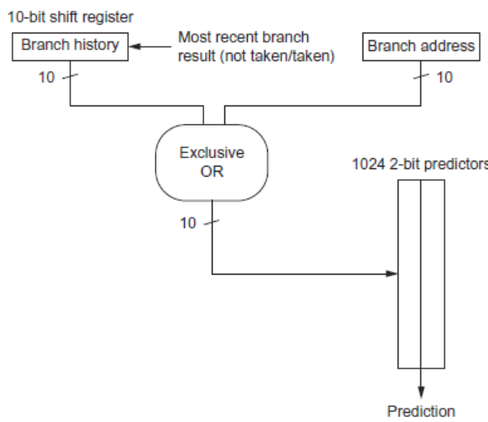
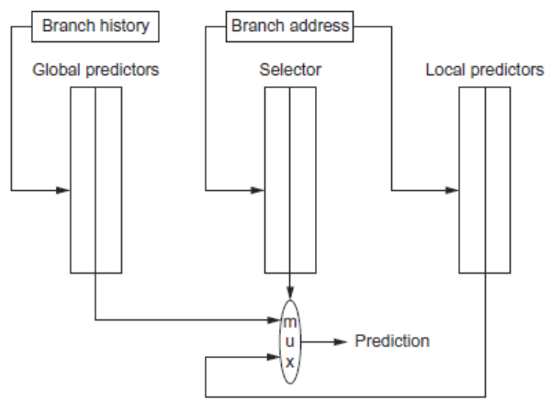
Branch Prediction
Branch Prediction
gshare
tournament

Slide 16
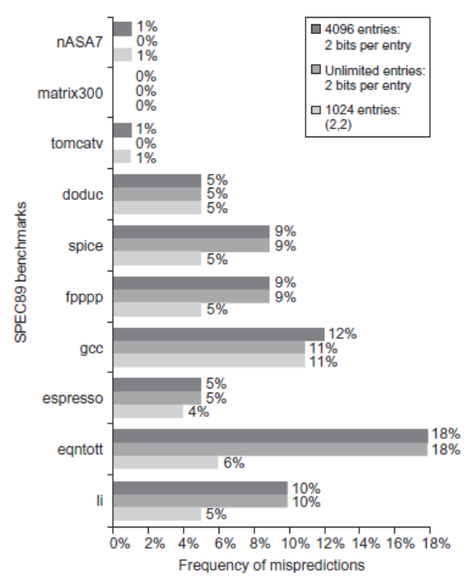
Branch Prediction Performance
Branch Prediction

Slide 17
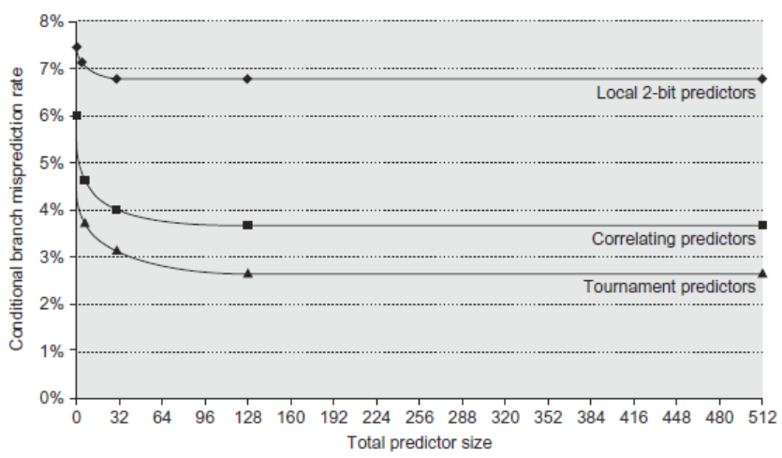
Branch Prediction Performance
Branch Prediction

Slide 18
Tagged Hybrid Predictors
Branch Prediction
Need to have predictor for each branch and history
Problem: this implies huge tables
Solution:
Use hash tables, whose hash value is based on branch address and branch history
Longer histories may lead to increased chance of hash collision, so use multiple tables with increasingly shorter histories

Slide 19
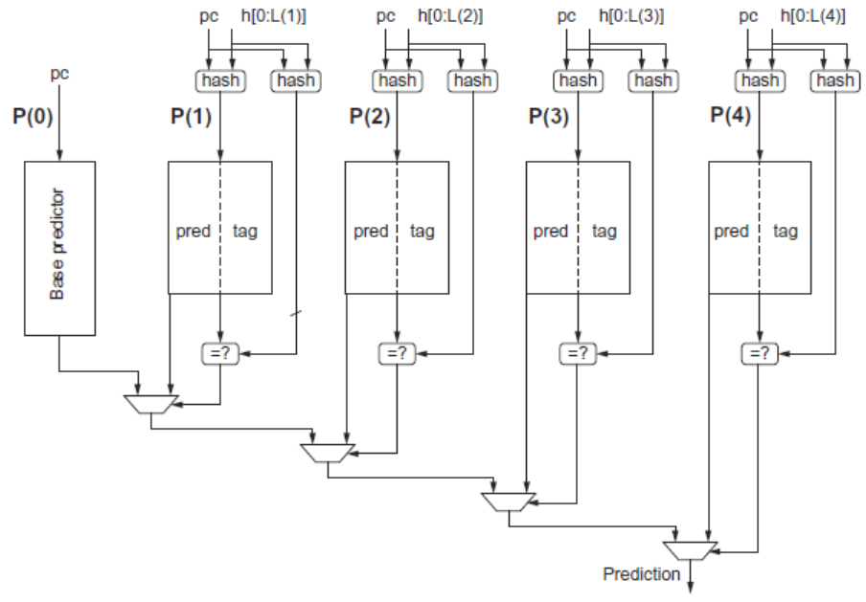
Tagged Hybrid Predictors
Branch Prediction

Slide 20
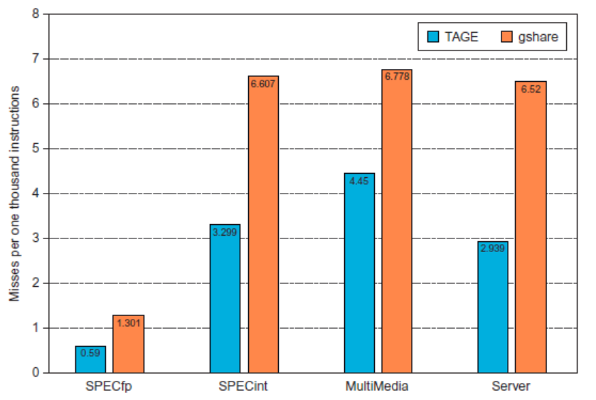
Tagged Hybrid Predictors
Branch Prediction

Slide 21
Dynamic Scheduling
Dynamic Scheduling
Rearrange order of instructions to reduce stalls while maintaining data flow
Advantages:
Compiler doesn’t need to have knowledge of microarchitecture
Handles cases where dependencies are unknown at compile time
Disadvantage:
Substantial increase in hardware complexity
Complicates exceptions

Slide 22
Dynamic Scheduling
Dynamic Scheduling
Dynamic scheduling implies:
Out-of-order execution
Out-of-order completion
Example 1:
fdiv.d f0,f2,f4
fadd.d f10,f0,f8
fsub.d f12,f8,f14
fsub.d is not dependent, issue before fadd.d

Slide 23
Dynamic Scheduling
Dynamic Scheduling
Example 2:
fdiv.d f0,f2,f4
fmul.d f6,f0,f8
fadd.d f0,f10,f14
fadd.d is not dependent, but the antidependence makes it impossible to issue earlier without register renaming

Slide 24
Register Renaming
Dynamic Scheduling
Example 3:
fdiv.d f0,f2,f4
fadd.d f6,f0,f8
fsd f6,0(x1)
fsub.d f8,f10,f14
fmul.d f6,f10,f8
name dependence with f6
antidependence
antidependence

Slide 25
Register Renaming
Dynamic Scheduling
Example 3:
fdiv.d f0,f2,f4
fadd.d S,f0,f8
fsd S,0(x1)
fsub.d T,f10,f14
fmul.d f6,f10,T
Now only RAW hazards remain, which can be strictly ordered

Slide 26
Register Renaming
Dynamic Scheduling
Tomasulo’s Approach
Tracks when operands are available
Introduces register renaming in hardware
Minimizes WAW and WAR hazards
Register renaming is provided by reservation stations (RS)
Contains:
The instruction
Buffered operand values (when available)
Reservation station number of instruction providing the operand values

Slide 27
Register Renaming
Dynamic Scheduling
RS fetches and buffers an operand as soon as it becomes available (not necessarily involving register file)
Pending instructions designate the RS to which they will send their output
Result values broadcast on a result bus, called the common data bus (CDB)
Only the last output updates the register file
As instructions are issued, the register specifiers are renamed with the reservation station
May be more reservation stations than registers
Load and store buffers
Contain data and addresses, act like reservation stations

Slide 28
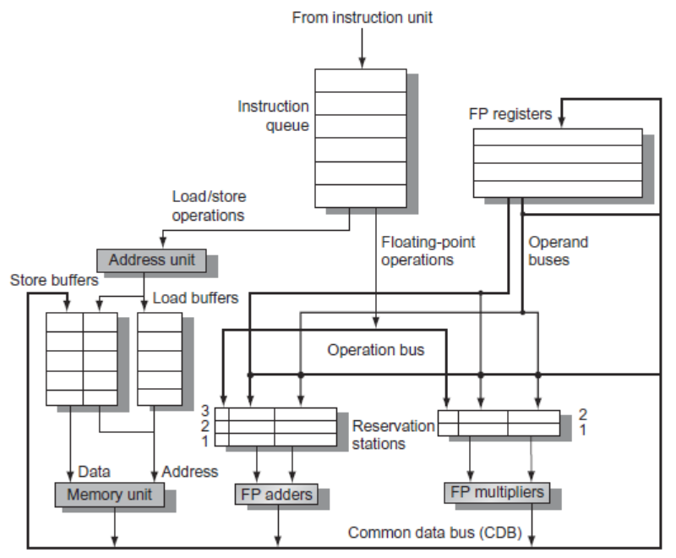
Tomasulo’s Algorithm
Dynamic Scheduling

Slide 29
Tomasulo’s Algorithm
Dynamic Scheduling
Three Steps:
Issue
Get next instruction from FIFO queue
If available RS, issue the instruction to the RS with operand values if available
If operand values not available, stall the instruction
Execute
When operand becomes available, store it in any reservation stations waiting for it
When all operands are ready, issue the instruction
Loads and store maintained in program order through effective address
No instruction allowed to initiate execution until all branches that proceed it in program order have completed
Write result
Write result on CDB into reservation stations and store buffers
(Stores must wait until address and value are received)

Slide 30
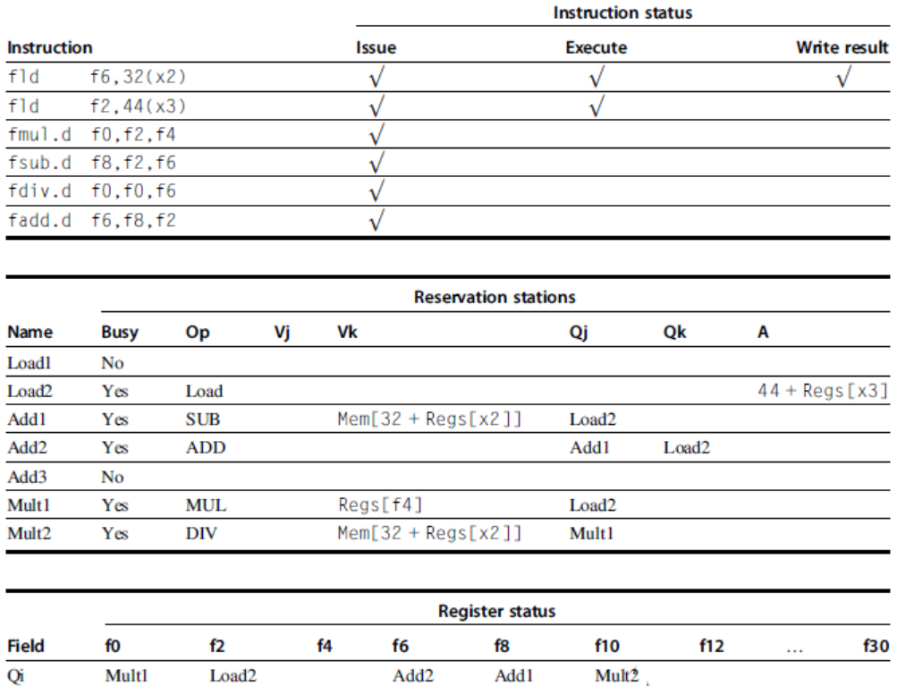
Example
Dynamic Scheduling

Slide 31
Tomasulo’s Algorithm
Dynamic Scheduling
Example loop:
Loop: fld f0,0(x1)
fmul.d f4,f0,f2
fsd f4,0(x1)
addi x1,x1,8
bne x1,x2,Loop // branches if x16 != x2

Slide 32
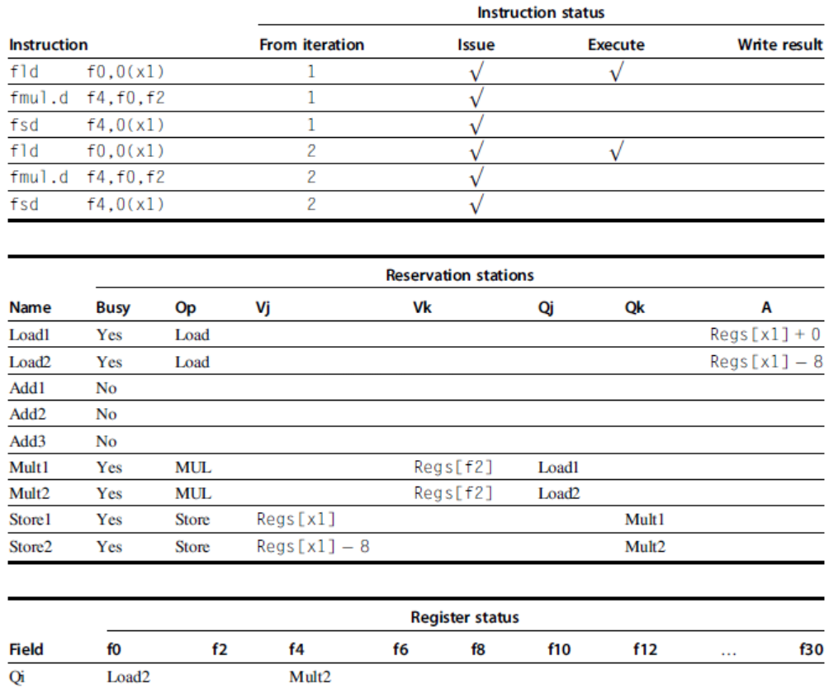
Tomasulo’s Algorithm
Dynamic Scheduling

Slide 33
Hardware-Based Speculation
Execute instructions along predicted execution paths but only commit the results if prediction was correct
Instruction commit: allowing an instruction to update the register file when instruction is no longer speculative
Need an additional piece of hardware to prevent any irrevocable action until an instruction commits
I.e. updating state or taking an execution
Hardware-Based Speculation

Slide 34
Reorder Buffer
Reorder buffer – holds the result of instruction between completion and commit
Four fields:
Instruction type: branch/store/register
Destination field: register number
Value field: output value
Ready field: completed execution?
Modify reservation stations:
Operand source is now reorder buffer instead of functional unit
Hardware-Based Speculation

Slide 35
Reorder Buffer
Issue:
Allocate RS and ROB, read available operands
Execute:
Begin execution when operand values are available
Write result:
Write result and ROB tag on CDB
Commit:
When ROB reaches head of ROB, update register
When a mispredicted branch reaches head of ROB, discard all entries
Hardware-Based Speculation

Slide 36
Reorder Buffer
Register values and memory values are not written until an instruction commits
On misprediction:
Speculated entries in ROB are cleared
Exceptions:
Not recognized until it is ready to commit
Hardware-Based Speculation

Slide 37
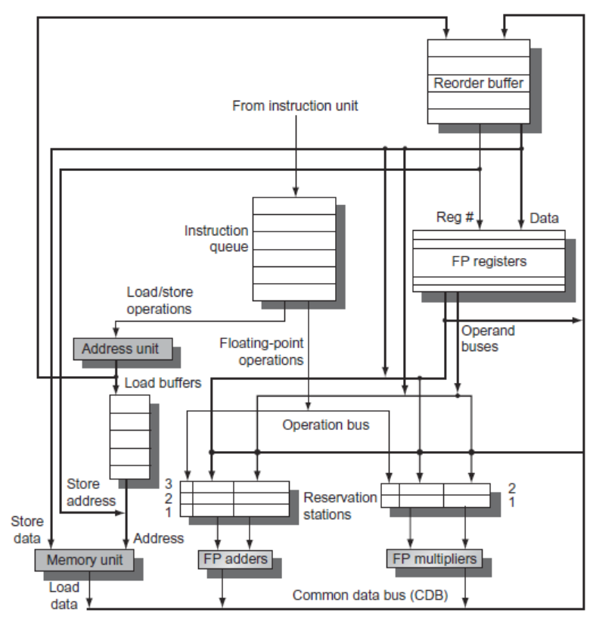
Reorder Buffer
Hardware-Based Speculation

Slide 38
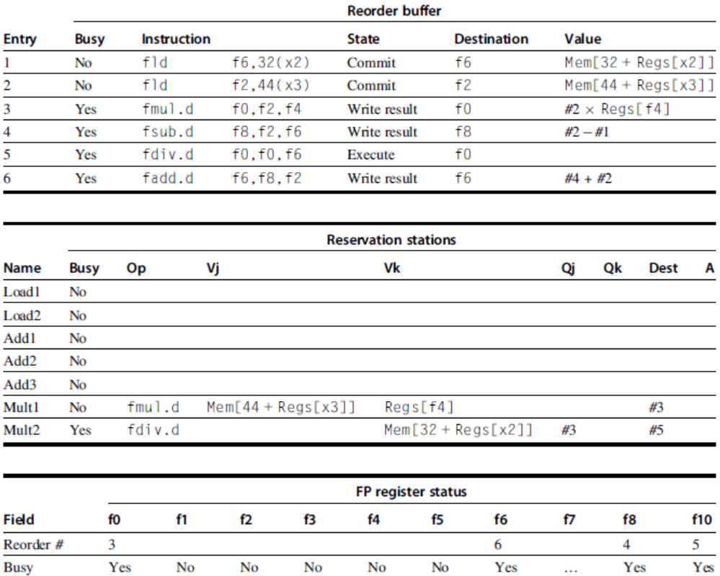
Reorder Buffer
Hardware-Based Speculation

Slide 39
Multiple Issue and Static Scheduling
To achieve CPI < 1, need to complete multiple instructions per clock
Solutions:
Statically scheduled superscalar processors
VLIW (very long instruction word) processors
Dynamically scheduled superscalar processors
Multiple Issue and Static Scheduling

Slide 40
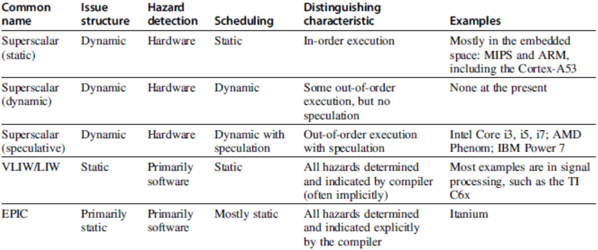
Multiple Issue
Multiple Issue and Static Scheduling

Slide 41
VLIW Processors
Package multiple operations into one instruction
Example VLIW processor:
One integer instruction (or branch)
Two independent floating-point operations
Two independent memory references
Must be enough parallelism in code to fill the available slots
Multiple Issue and Static Scheduling

Slide 42
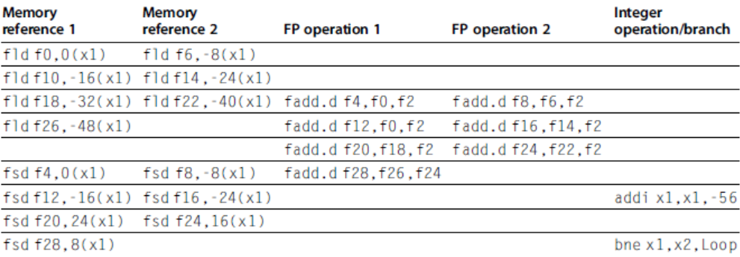
VLIW Processors
Multiple Issue and Static Scheduling
Disadvantages:
Statically finding parallelism
Code size
No hazard detection hardware
Binary code compatibility

Slide 43
Dynamic Scheduling, Multiple Issue, and Speculation
Modern microarchitectures:
Dynamic scheduling + multiple issue + speculation
Two approaches:
Assign reservation stations and update pipeline control table in half clock cycles
Only supports 2 instructions/clock
Design logic to handle any possible dependencies between the instructions
Issue logic is the bottleneck in dynamically scheduled superscalars
Dynamic Scheduling, Multiple Issue, and Speculation

Slide 44
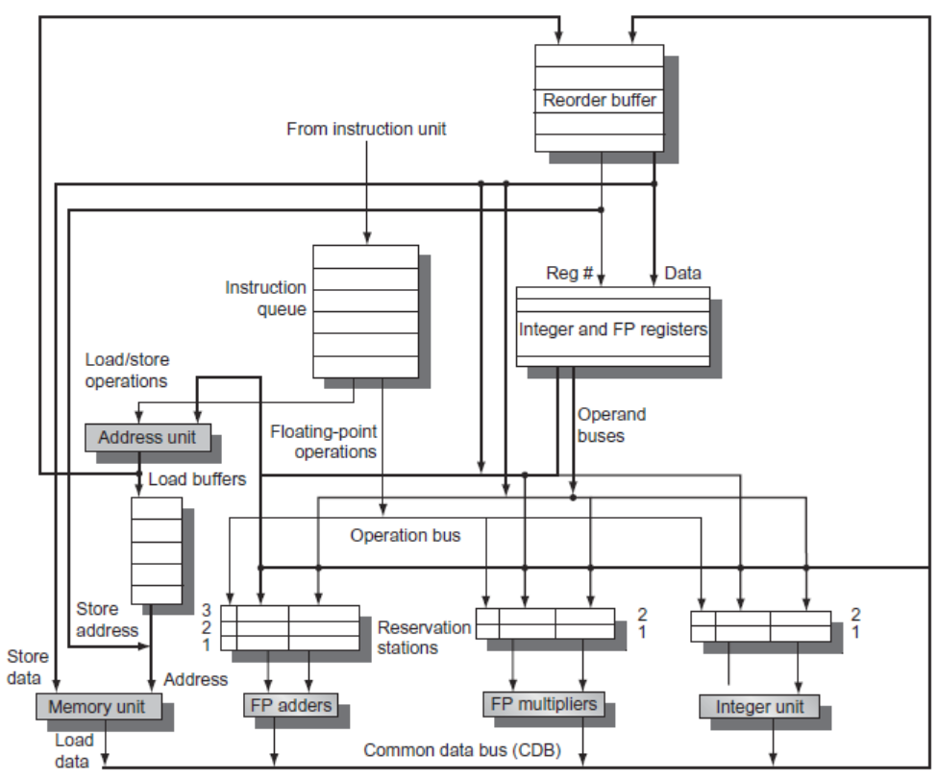
Overview of Design
Dynamic Scheduling, Multiple Issue, and Speculation

Slide 45
Multiple Issue
Examine all the dependencies amoung the instructions in the bundle
If dependencies exist in bundle, encode them in reservation stations
Also need multiple completion/commit
To simplify RS allocation:
Limit the number of instructions of a given class that can be issued in a “bundle”, i.e. on FP, one integer, one load, one store
Dynamic Scheduling, Multiple Issue, and Speculation

Slide 46
Example
Loop: ld x2,0(x1) //x2=array element
addi x2,x2,1 //increment x2
sd x2,0(x1) //store result
addi x1,x1,8 //increment pointer
bne x2,x3,Loop //branch if not last
Dynamic Scheduling, Multiple Issue, and Speculation

Slide 47
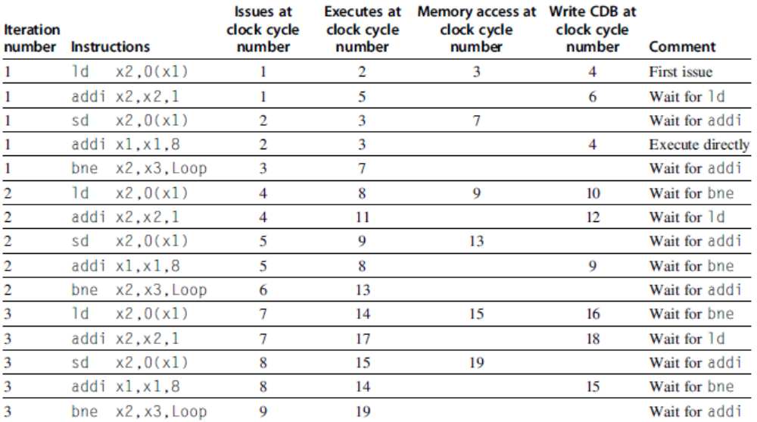
Example (No Speculation)
Dynamic Scheduling, Multiple Issue, and Speculation

Slide 48
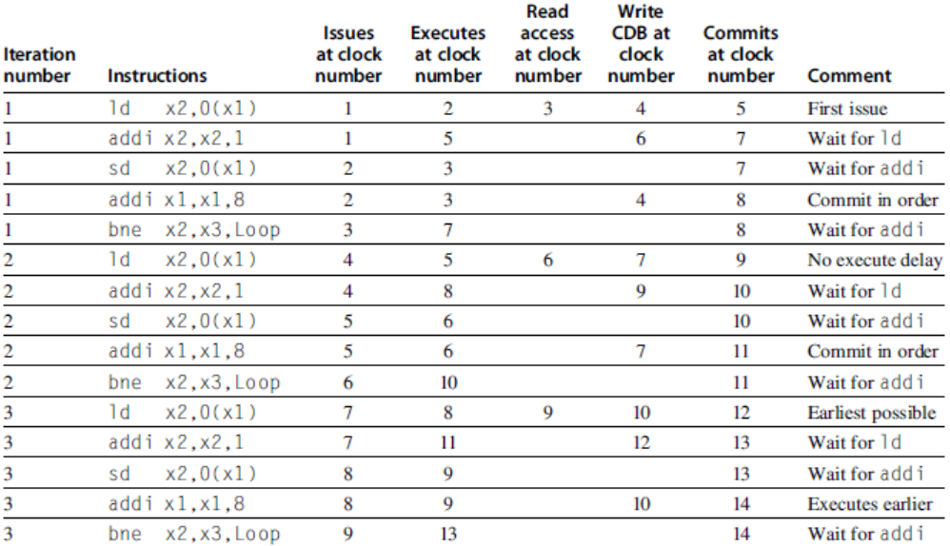
Example (Mutiple Issue with Speculation)
Dynamic Scheduling, Multiple Issue, and Speculation

Slide 49
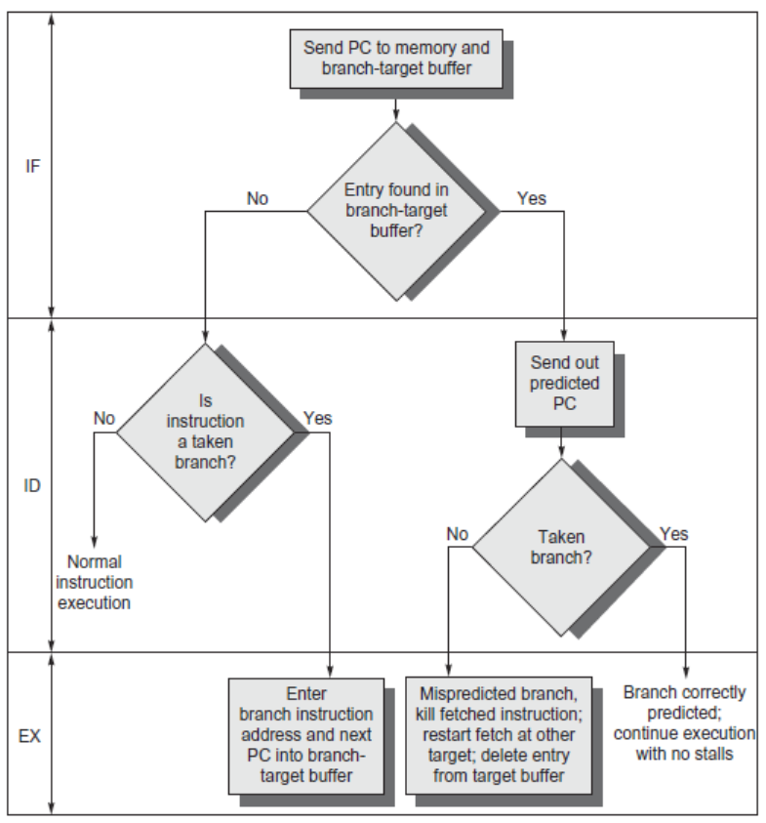
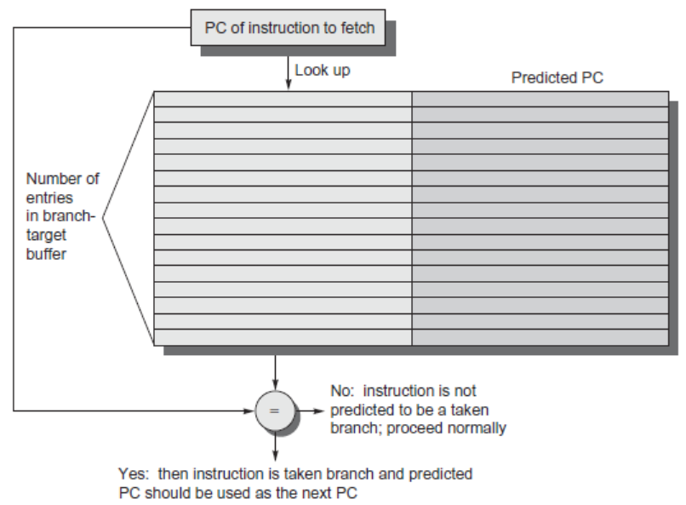
Branch-Target Buffer
Need high instruction bandwidth
Branch-Target buffers
Next PC prediction buffer, indexed by current PC
Adv. Techniques for Instruction Delivery and Speculation

Slide 50
Branch Folding
Optimization:
Larger branch-target buffer
Add target instruction into buffer to deal with longer decoding time required by larger buffer
“Branch folding”
Adv. Techniques for Instruction Delivery and Speculation

Slide 51
Return Address Predictor
Most unconditional branches come from function returns
The same procedure can be called from multiple sites
Causes the buffer to potentially forget about the return address from previous calls
Create return address buffer organized as a stack
Adv. Techniques for Instruction Delivery and Speculation

Slide 52
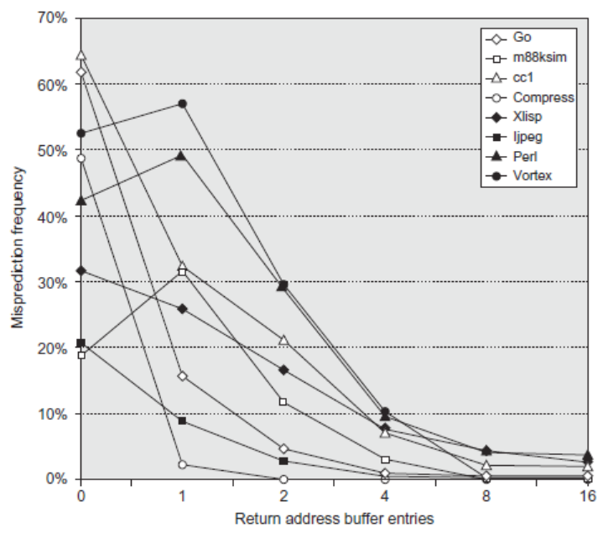
Return Address Predictor
Adv. Techniques for Instruction Delivery and Speculation

Slide 53
Integrated Instruction Fetch Unit
Design monolithic unit that performs:
Branch prediction
Instruction prefetch
Fetch ahead
Instruction memory access and buffering
Deal with crossing cache lines
Adv. Techniques for Instruction Delivery and Speculation

Slide 54
Register Renaming
Register renaming vs. reorder buffers
Instead of virtual registers from reservation stations and reorder buffer, create a single register pool
Contains visible registers and virtual registers
Use hardware-based map to rename registers during issue
WAW and WAR hazards are avoided
Speculation recovery occurs by copying during commit
Still need a ROB-like queue to update table in order
Simplifies commit:
Record that mapping between architectural register and physical register is no longer speculative
Free up physical register used to hold older value
In other words: SWAP physical registers on commit
Physical register de-allocation is more difficult
Simple approach: deallocate virtual register when next instruction writes to its mapped architecturally-visibly register
Adv. Techniques for Instruction Delivery and Speculation

Slide 55
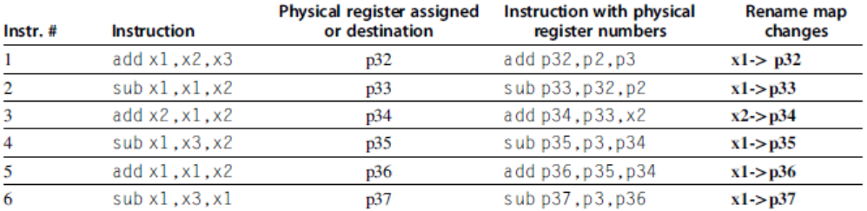
Integrated Issue and Renaming
Combining instruction issue with register renaming:
Issue logic pre-reserves enough physical registers for the bundle
Issue logic finds dependencies within bundle, maps registers as necessary
Issue logic finds dependencies between current bundle and already in-flight bundles, maps registers as necessary
Adv. Techniques for Instruction Delivery and Speculation

Slide 56
How Much?
How much to speculate
Mis-speculation degrades performance and power relative to no speculation
May cause additional misses (cache, TLB)
Prevent speculative code from causing higher costing misses (e.g. L2)
Speculating through multiple branches
Complicates speculation recovery
Speculation and energy efficiency
Note: speculation is only energy efficient when it significantly improves performance
Adv. Techniques for Instruction Delivery and Speculation

Slide 57
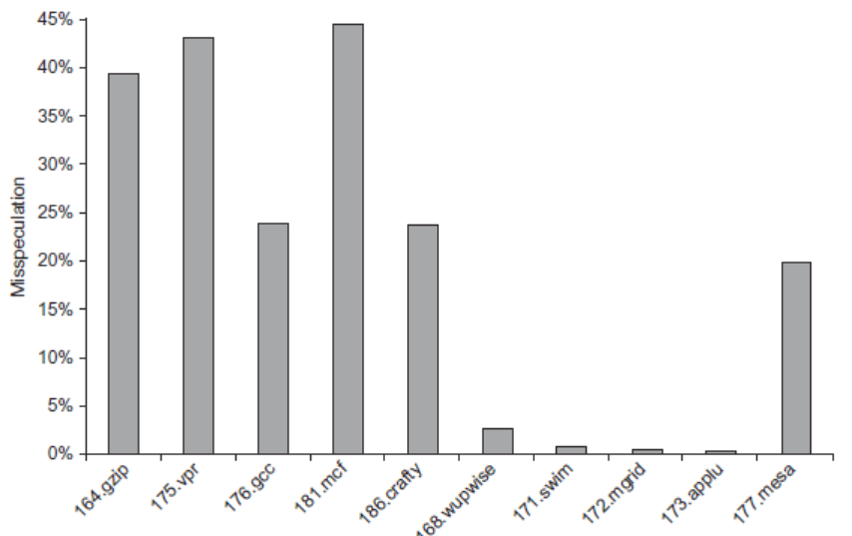
How Much?
integer
Adv. Techniques for Instruction Delivery and Speculation

Slide 58
Energy Efficiency
Value prediction
Uses:
Loads that load from a constant pool
Instruction that produces a value from a small set of values
Not incorporated into modern processors
Similar idea--address aliasing prediction--is used on some processors to determine if two stores or a load and a store reference the same address to allow for reordering
Adv. Techniques for Instruction Delivery and Speculation

Slide 59
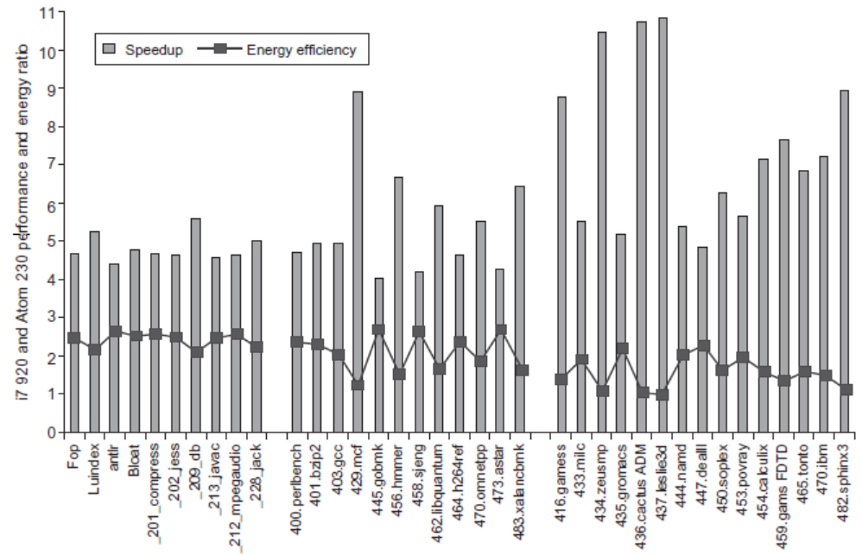
Fallacies and Pitfalls
Fallacies and Pitfalls
It is easy to predict the performance/energy efficiency of two different versions of the same ISA if we hold the technology constant

Slide 60
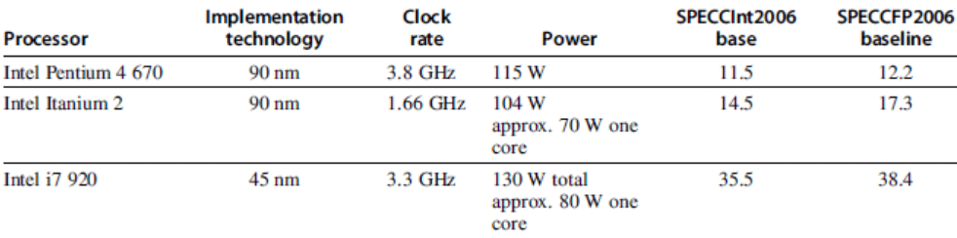
Fallacies and Pitfalls
Fallacies and Pitfalls
Processors with lower CPIs / faster clock rates will also be faster
Pentium 4 had higher clock, lower CPI
Itanium had same CPI, lower clock

Slide 61
Fallacies and Pitfalls
Fallacies and Pitfalls
Sometimes bigger and dumber is better
Pentium 4 and Itanium were advanced designs, but could not achieve their peak instruction throughput because of relatively small caches as compared to i7
And sometimes smarter is better than bigger and dumber
TAGE branch predictor outperforms gshare with less stored predictions

Slide 62
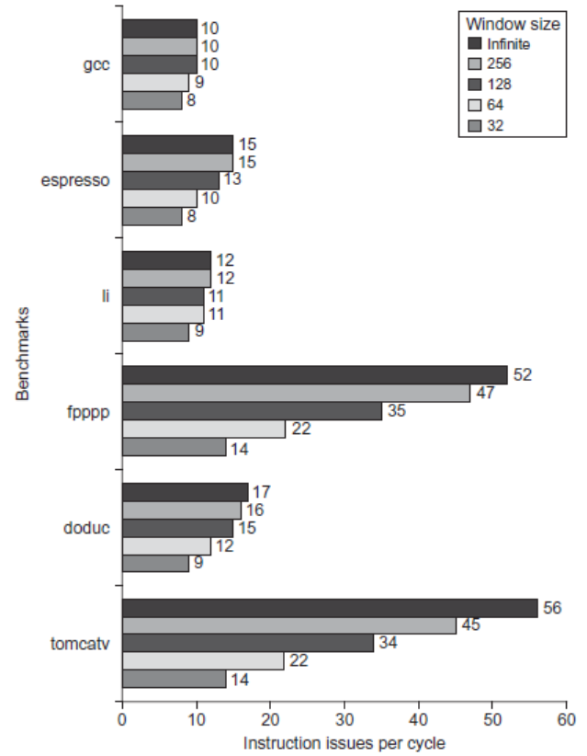
Fallacies and Pitfalls
Fallacies and Pitfalls
Believing that there are large amounts of ILP available, if only we had the right techniques

